Slide 1
Chapter 8
Fundamental Sampling Distributions
and Data Descriptions

Slide 2
Why this chapter is critical:
Foundation of confidence intervals
Foundation of hypothesis testing
Core of modern data science

Slide 3
Big Idea of the Chapter
In real life:
We never know the population parameter.
We only observe a sample.
The key question:
How does a statistic behave across different samples?
That behavior is called:
Sampling Distribution

Slide 4
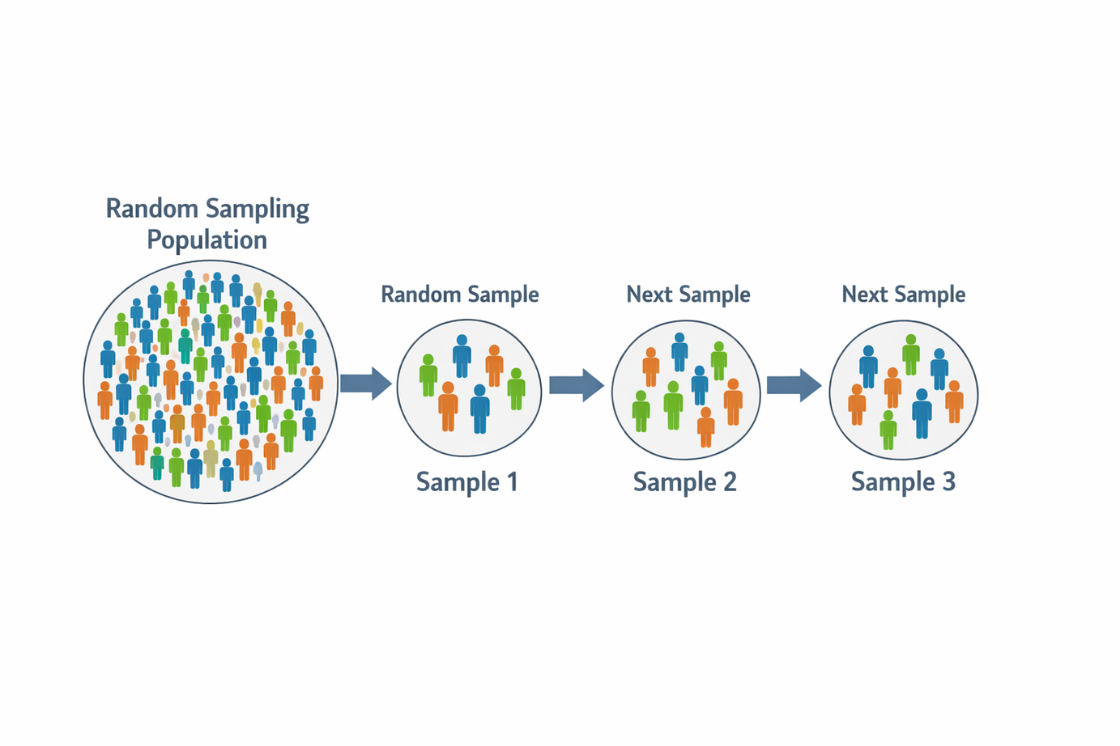
Random Sampling
A random sample:
X1,X2,...,Xn
Independent
Identically distributed (i.i.d.)
From the same population
Why independence matters:
No hidden correlation
No bias in variability

Slide 5
Important Sample Statistics
We study these statistics:
Sample mean X^2
Sample variance S^2
Sample proportion p^
These are random variables because samples vary.

Slide 6
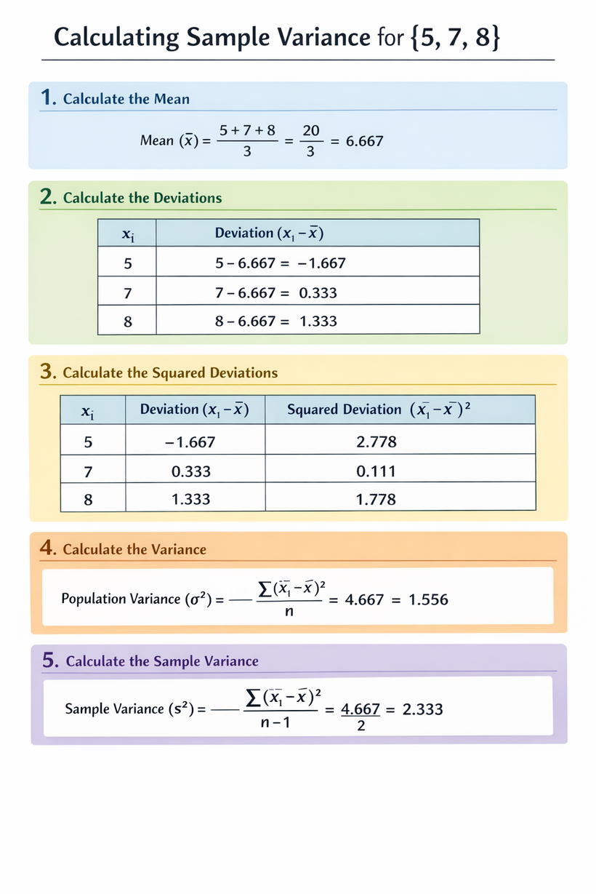

Sample Variance
Why divide by n−1?
Because:
We lose 1 degree of freedom when estimating the mean.
This makes variance unbiased.

Slide 7

Degrees of Freedom
Intuition:
Once the mean is fixed, only n−1 deviations are free.
This concept is crucial for:
t-distribution
Chi-square distribution
F-distribution

Slide 8
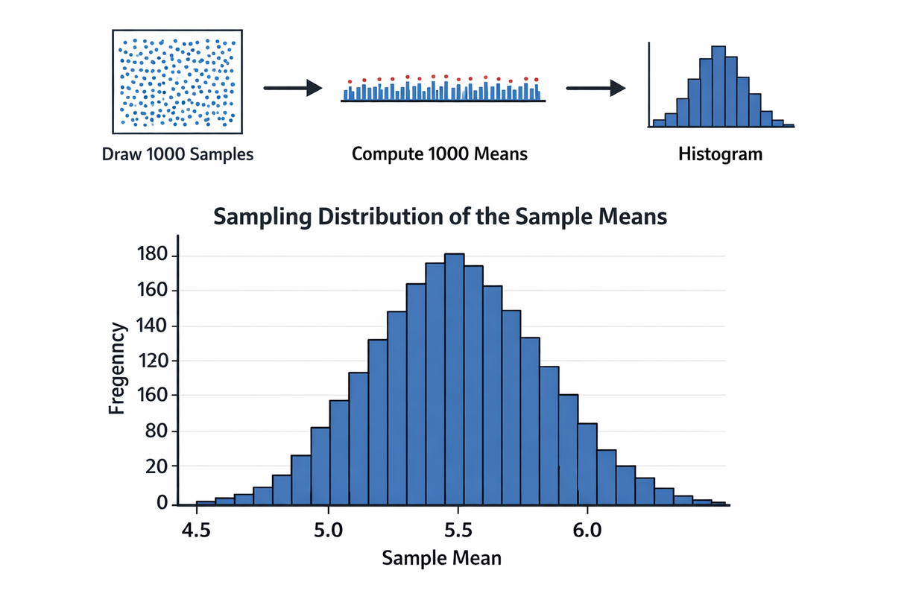
What Is a Sampling Distribution?
Definition:
A sampling distribution is
the probability distribution of a statistic.
Important:
It is NOT:
The population distribution
The sample histogram
It is:
The distribution of the statistic over repeated samples.

Slide 9
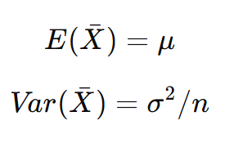
Sampling Distribution of the Mean
Interpretation:
The sample mean is unbiased.
Variability decreases as sample size increases.

Slide 10
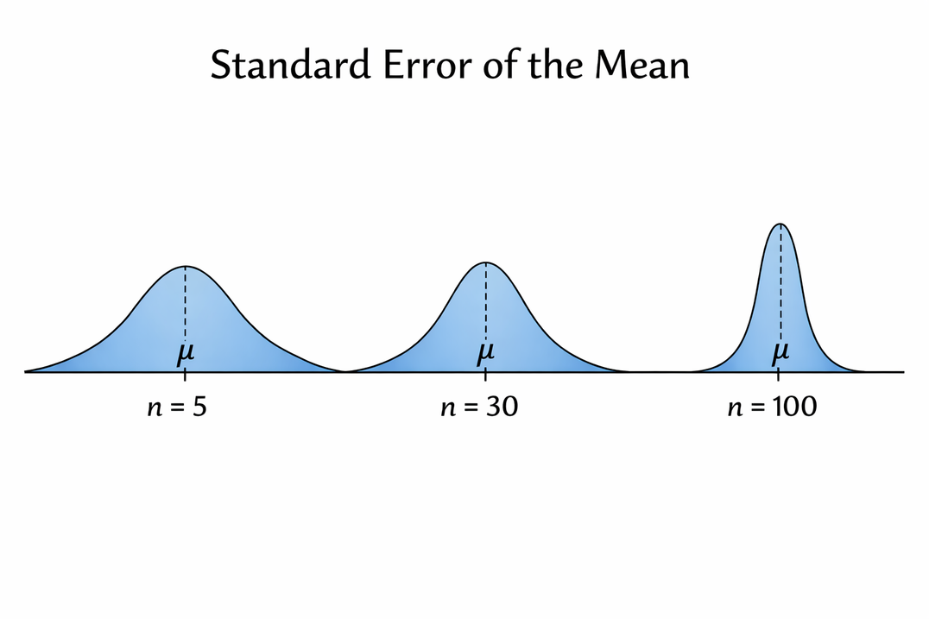

Standard Error of the Mean
Standard Error (SE):
Measures spread of sample means.
Key insight:
Larger n → smaller SE → more precision.

Slide 11
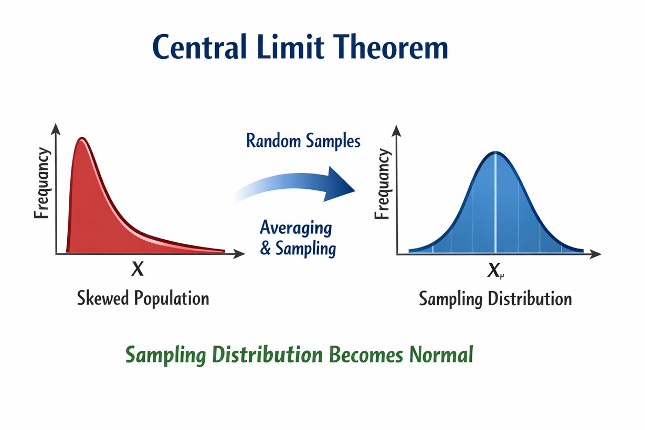

Central Limit Theorem
If n is large:
The distribution of X
becomes approximately normal.
Even if the population is NOT normal.

Slide 12

When Population Is Normal
If population is normal:
This holds for ANY sample size.
That allows:
Exact inference
Exact probabilities

Slide 13
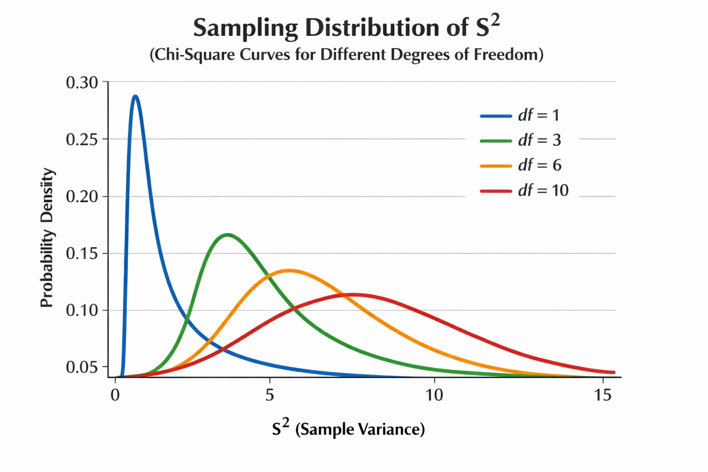

Sampling Distribution of S²
If population is normal:
This follows a Chi-Square distribution.
Properties:
Right-skewed
Depends on degrees of freedom

Slide 14
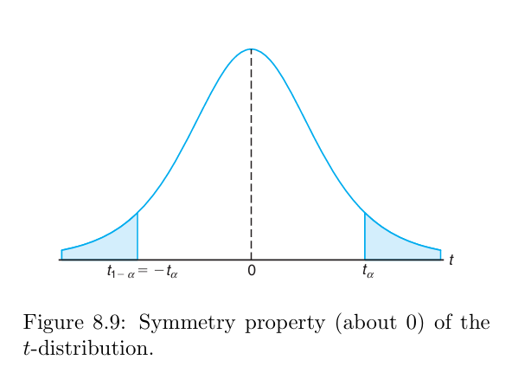
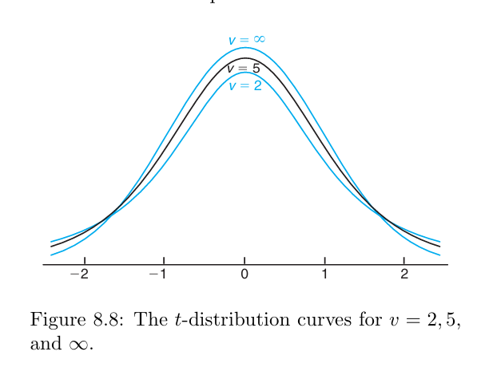

t-Distribution
Used when:
Population variance unknown
Small samples
Properties:
Symmetric
Heavier tails than normal
Depends on df

Slide 15
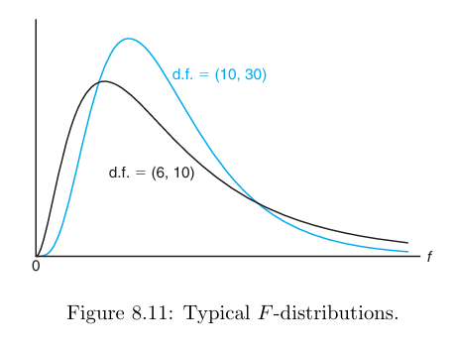

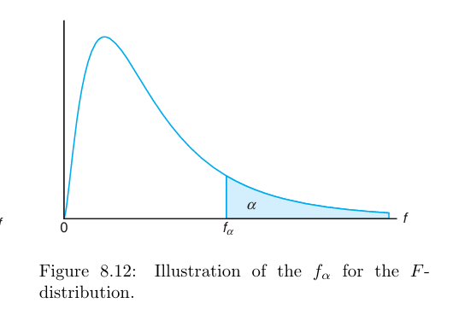
F-Distribution
Used to compare variances.
Properties:
Always positive
Right-skewed
Two degrees of freedom

Slide 16
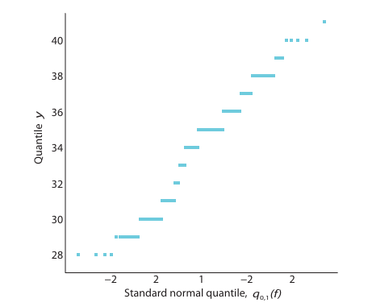
Quantile & Probability Plots
Purpose:
Check if data are normally distributed.
If points follow straight line → normality reasonable.

Slide 17
Real-World Example
Example:
A factory produces bolts.
Population mean length = 10 mm
σ = 0.5 mm
Sample size n = 25
Standard error:
SE = 0.5 / √25 = 0.1
Interpretation:
Sample means typically vary by 0.1 mm.
Explain:
How CLT helps estimate probability mean > 10.2 mm.

Slide 18
Common Mistakes
Why This Chapter Is Powerful
Sampling distribution ≠ sample distribution
Large n does NOT fix bias
Independence assumption is critical
t-distribution approaches normal as df increases
This chapter enables:
Chapter 9 → Confidence Intervals
Chapter 10 → Hypothesis Testing
Chapter 11 → Regression Inference
Chapter 13 → ANOVA
Without sampling distributions, inference is impossible.

